Slide 1
FEATURES OF PROJECT:
USER: OTHER USERS:
1.View Calender 1.View Calender
2.View Diary
3.Edit Diary DIARY DATABASE:
4.Add Diary 1.View Dairy
5.Delete Diary 2.Edit Dairy
6.Change Password 3.Add Dairy

Slide 2
Use-Case Descriptions
Use Case ID: UC01
Name: View calender
Actors: User
Description: Allows any Users to view calender in Multiple Languages
Pre-conditions: None
Post-conditions: None
Main Flow:
USER: | SYSTEM:
User selects view calender | 1.System takes the input
2.Users selects the language | 2.System displays the calender

Slide 3
Use Case ID: UC02
Name: View Dairy
Actors: User
Description: Allows user to View Dairy
Pre-conditions: user should enter password
Post-conditions: Selected Dairy is displayed
Main Flow:
USER | SYSTEM
1.Users selects View dairy Option | 1.System Checks the Password
2.User enters the password | 2.Takes inputs checks if file exits
3.Users enters the date of dairy | 3.Displays the Dairy by retrieving file

Slide 4
Use Case ID: UC03
Name: Edit Dairy
Actors: User
Description: Allows users to edit existing dairy
Pre-conditions: User should enter password
Post-conditions: None
Main Flow:
USER | SYSTEM
1.Users selects the Edit diary option | 1.System the checks the password
2.User enters the password | 2.Checks if the asked file exist
3.Users enters the date of dairy to be edited | 3.If exist the allows user to retrieve file from system and edit it

Slide 5
Use Case ID: UC04
Name: Add Dairy
Actors: User
Description: Allows user to Add new Dairy
Pre-conditions: User should enter password
Post-conditions: None
Main Flow:
USER | SYSTEM
1.Users selects add dairy option | 1.System asks the password
2.Users enter the password | 2.If password is correct allows user the create file
3.User enters the date and time | 3.System takes the given data and stores in a file

Slide 6
Use Case ID: UC05
Name: Delete Dairy
Actors: User
Description: Allows User to delete existing Dairy
Pre-conditions: Password should be entered
Post-conditions: None
Main Flow:
USER | SYSTEM
1.User selects delete dairy option | 1.System checks if password is correct
2.User enters password | 2.Delet’s the given dated file from System

Slide 7
Use-Case Descriptions
Use Case ID: UC06
Name: Change Password
Actors: User
Description: Allows users to change password
Pre-conditions: Password should be entered
Post-conditions: New password should be given
Main Flow:
USER | SYSTEM
1.User selects change password option | 1.System checks if password is correct
2.User enter the old password | 2.Asks user for new password

Slide 8
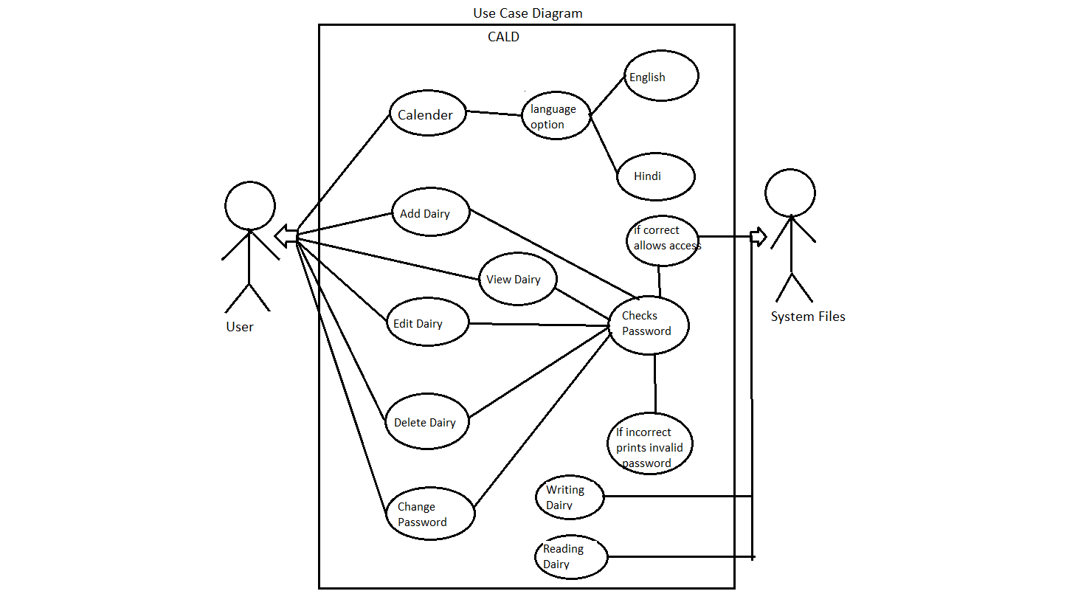
Telugu

